Slide 1



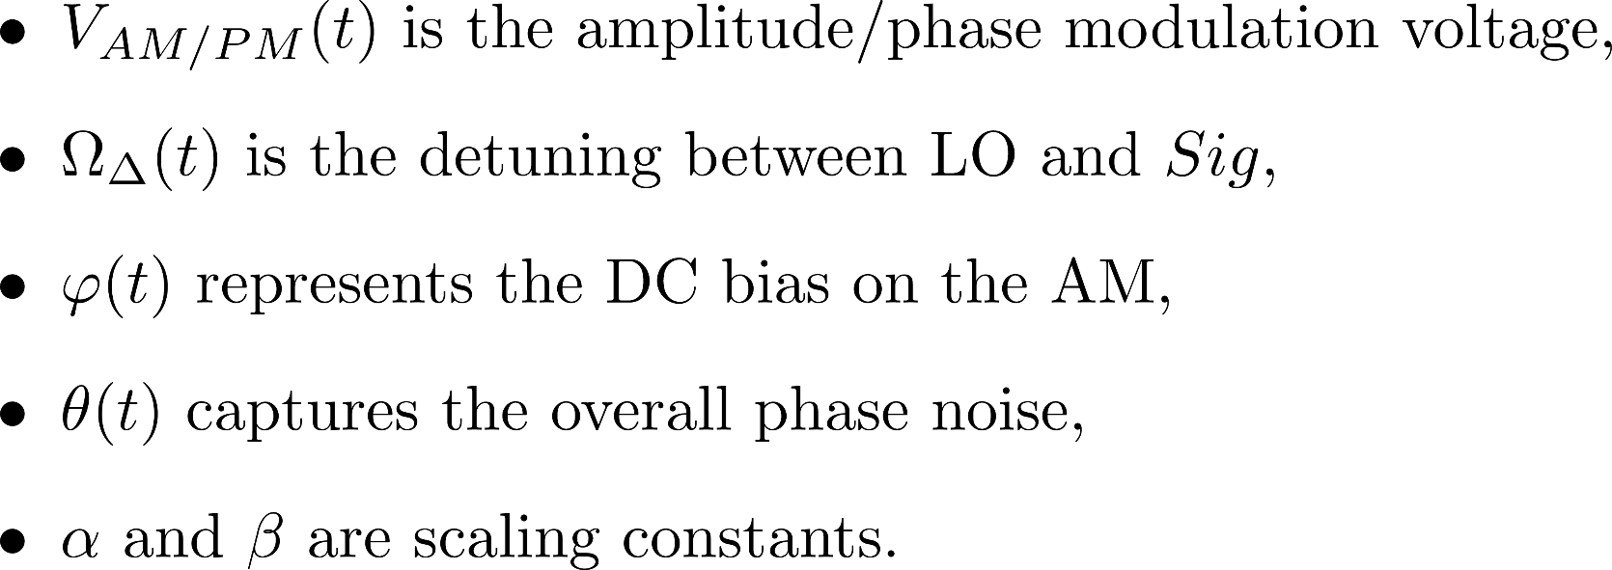
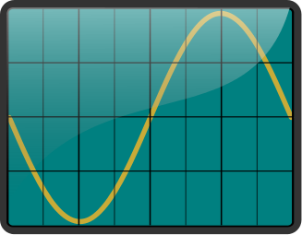
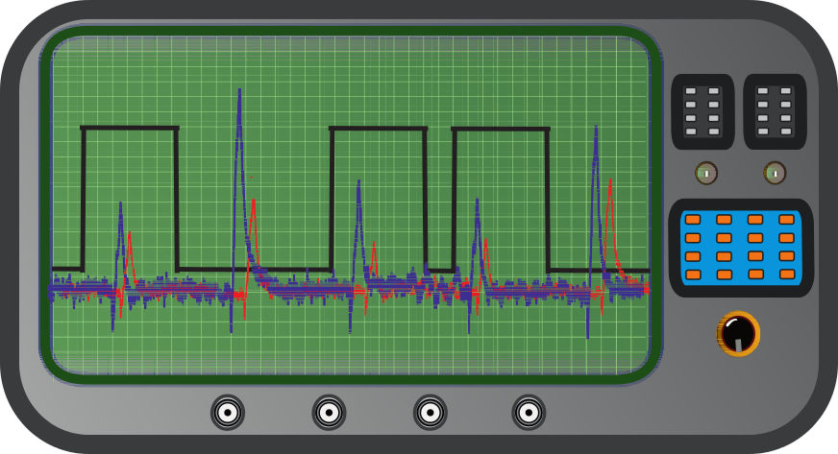
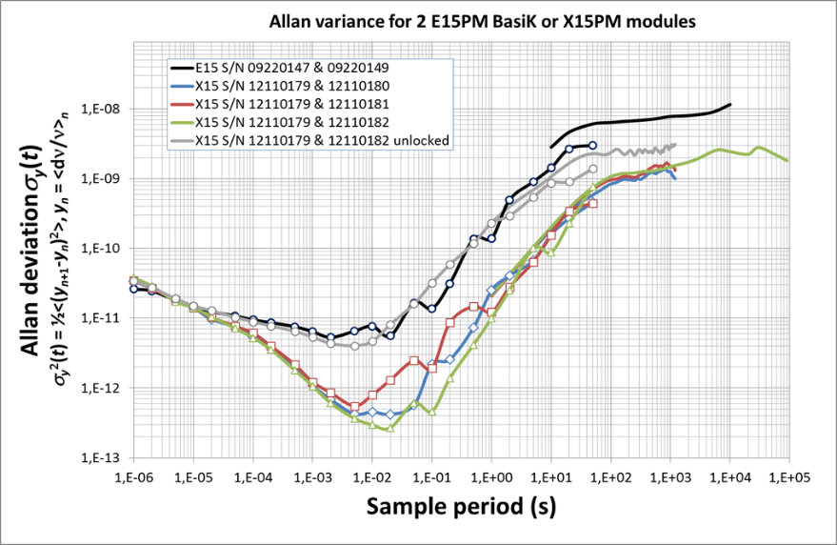
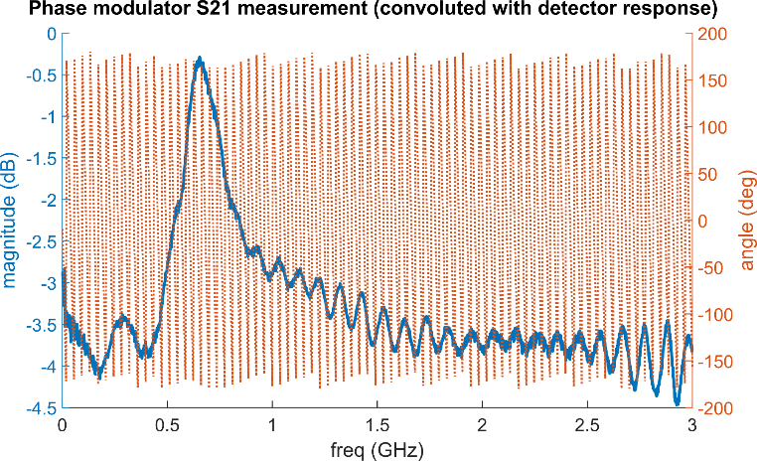
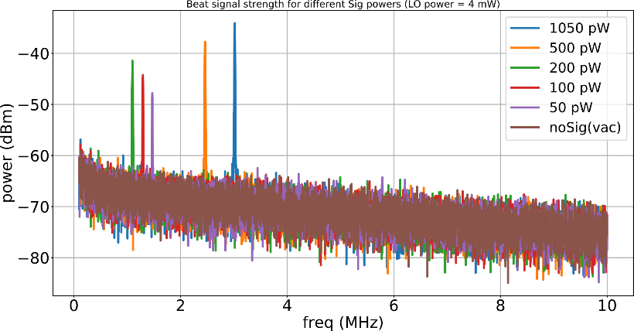
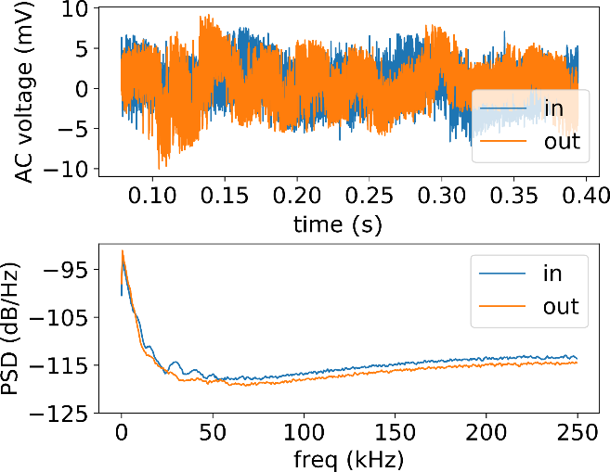
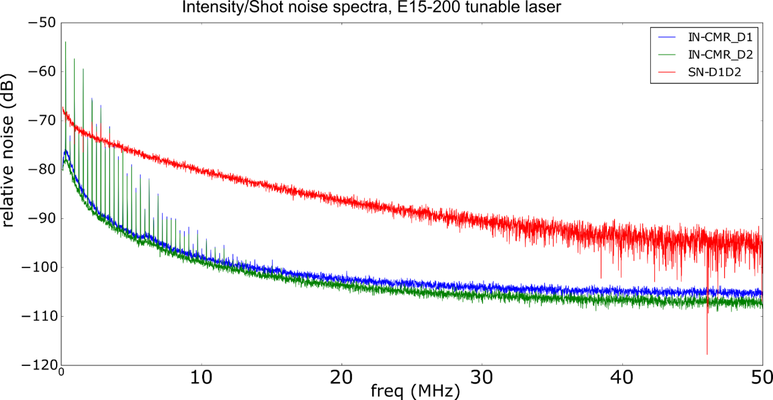
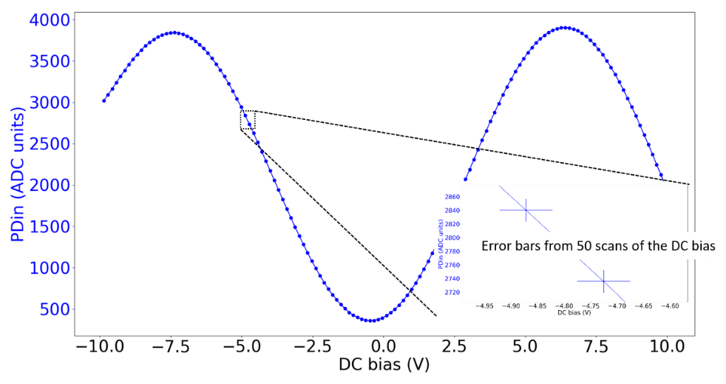
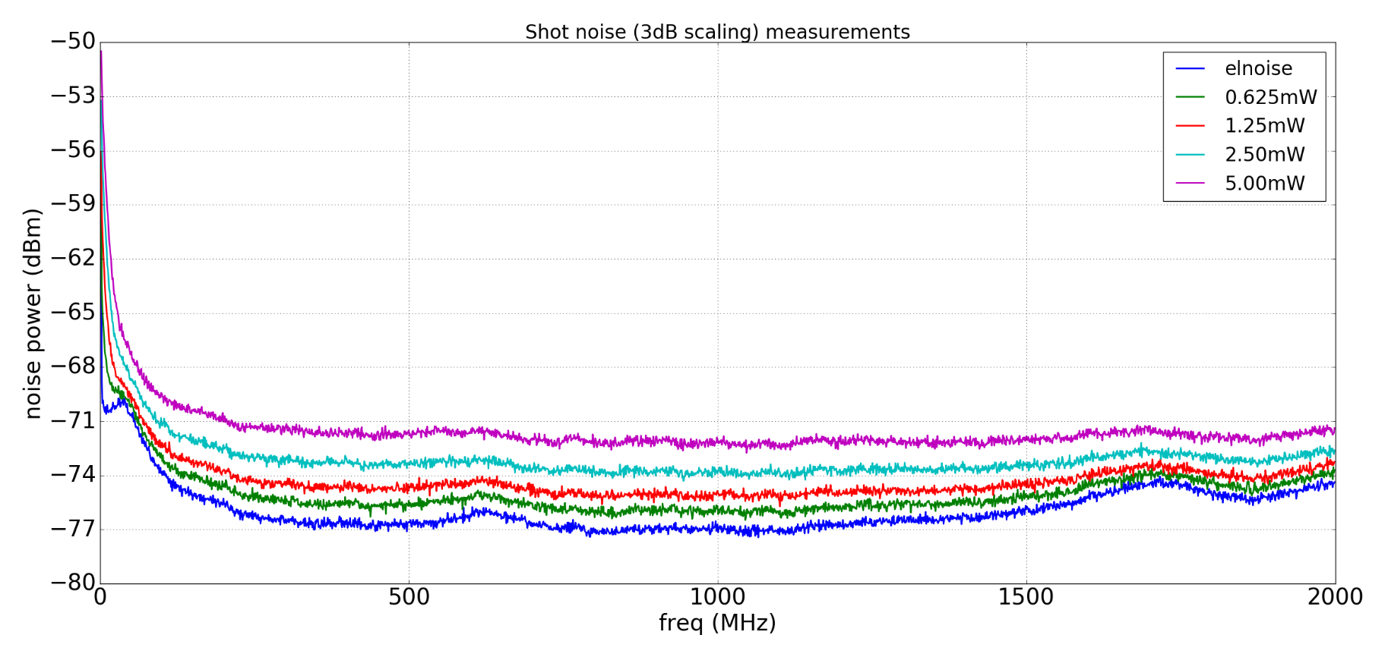
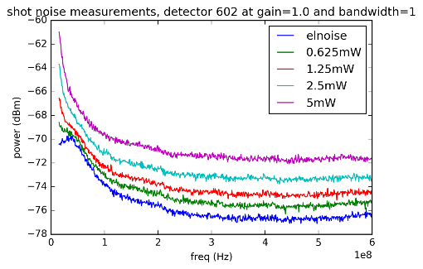
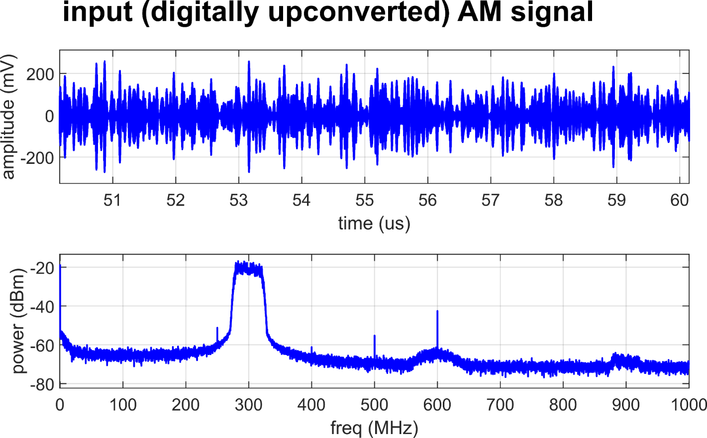
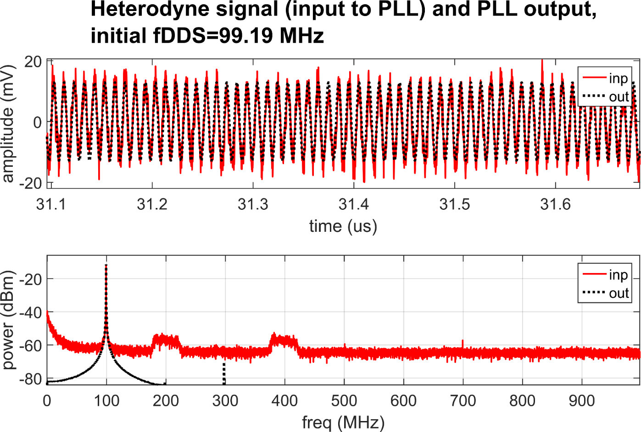
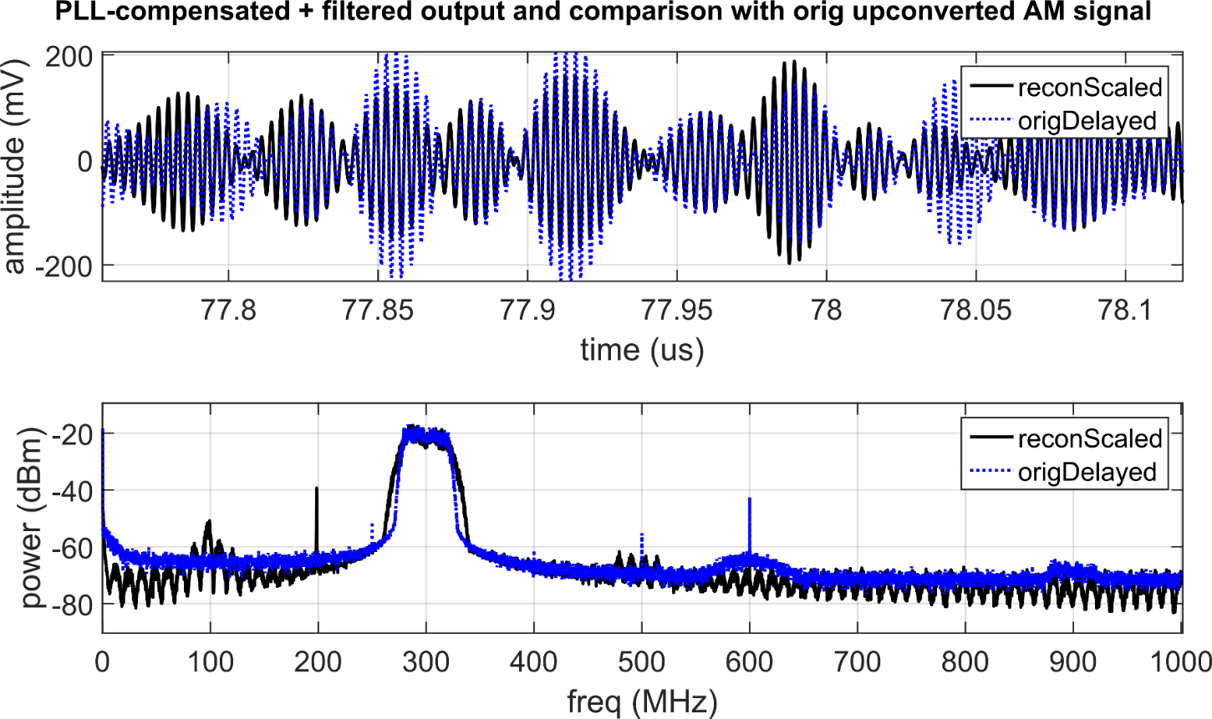
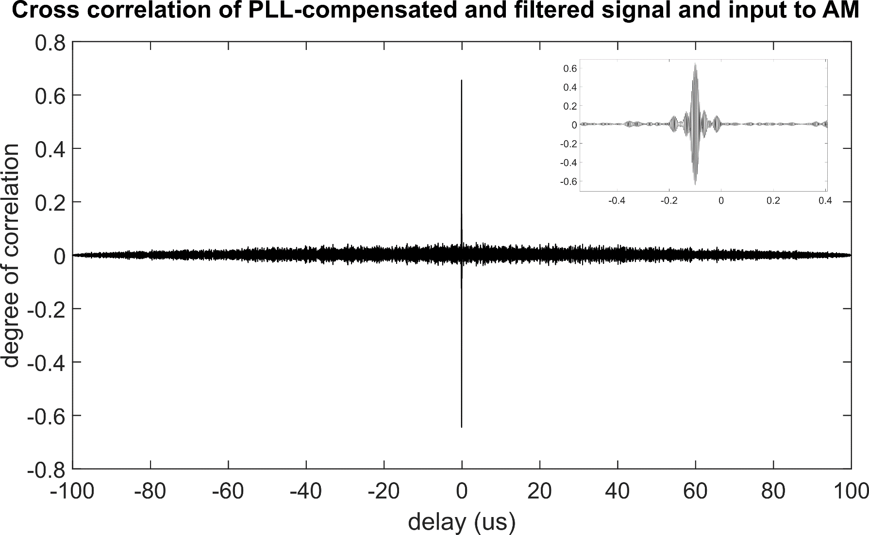
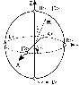
Investigating feasibility of broadband continuous variable quantum key distribution in telecom fibers with local local oscillator
N. Jain,¹ C.S. Jacobsen,¹ D. Solar Nikolic,¹ A. Kordts,¹ C. Lupo,²
R. Grigoryan,¹ T. Pedersen,³ S. Pirandola,^{2,4} T. Gehring,¹ and U.L. Andersen¹
¹Department of Physics, Fysikvej 309, Technical University of Denmark, 2800 Kongens Lyngby, Denmark
²York Centre for Quantum Technologies (YCQT), University of York, York YO10 5GH, United Kingdom
³Cryptomathic A/S, Jaegergardsgale 118, 8000 Aarhus, Denmark
⁴Department of Computer Science, University of York, York YO10 5GH, United Kingdom
Introduction
Design dilemmas: transmitted LO vs. local LO & homodyne vs. heterodyne
Continuous-variable quantum key distribution (CVQKD) implementations have the potential to reach Gbit key rates while staying cost-effective by using standard telecom technology.
One possible realization, for instance, is via encoding quantum states in GHz-wide optical sidebands (at Alice) and decoding them with a broadband coherent detector (at Bob).
Here, we present the progress in realization of such a CV-QKD scheme using coherent states with Gaussian modulation, and the various challenges in adapting the security proof to real-world scenarios.
We use the recently proposed local local oscillator (LO) design and heterodyne detection in Bob to recover the info in the quantum signal (qSig) from Alice.
laser
local oscillator (LO)
Bob
LO
Alice
quantum
channel
laser
LLO
coherent
detection
+ phase
reference
alignment
Transmitted LO design
MUX
DEMUX
coherent
detection
Local LO design
Modulation, addition
of reference signal,
and attenuation to
quantum level
Alice
Modulation &
attenuation to
quantum level
quantum
channel
qSig
laser
qSig + ref Sig
quantum signal (qSig)
Bob
Stable relative phase between qSig and LO at the receiver
Vulnerable to LO intensity/wavelength manipulation on quantum channel
LO intensity limitation at Bob due to propagation losses and nonlinear effects
High requirments on lasers’ phase noise + complex phase reference alignment
LO can be fully trusted, security loopholes closed
No limitation on the local LO intensity
LO
LO
Expression for output current of balanced heterdoyne receiver:
Heterodyne setup
Dual homodyne setup
90 deg
optical
hybrid
Relatively
simple
analog
electronics
processing
Rather complex
digital + analog
electronics
processing
Sig
Sig
Info of signal directly in baseband therefore simple electronics.
Expensive (1 hybrid + 1 extra detector).
Not so suitable when LO and qSig frequencies are detuned (Ω_{Δ} ≠ 0).
Complex electronics requiring downconversion etc.
Less sensitive to deviations of parameters, such as splitting ratio.
Classically well-studied problem.
Assuming small modulation depths, negligible phase noise and drifts etc:
Current setup and component characterization
Ch1
Arbitrary waveform
generator (AWG)
Alice
Ch2
LLO
laser
heterodyne detection
(ω_{b} ≠ 0)
-
Signal
laser
Intensity
modulator
(IM)
Phase
modulator
(PM)
Variable
attenuator
(VATT)
Quantum
channel
Bob
polarization maintaining fiber (PMF)
single mode fiber (SMF)
Beat signal strength measurements. The LO and signal lasers are slightly detuned in frequency, and the beat signal is measured via the broadband heterodyne detector. Estimating the strength of this beat signal is necessary to gauge how well the filtering would eventually work, and how can the bits (from the oscilloscope/ADC) be partitioned between the quantum and the beat signal.
Shot noise measurements on the broadband heterodyne detector. Noise traces measured on a spectrum analyzer for different LO powers input at the 50/50 splitter before the detector. The inset shows the same response from near DC to 600 MHz, and it can be observed that it is quite non-uniform. The clearance from the electronic noise floor (blue trace) is also just around 6 dB at the max LO power, above which the detector saturates.
Noise characteristics of the lasers. (Top) Allan deviation of the beat between two E15 or X15 lasers from NKT Photonics. (Bottom) Intensity/shot noise (IN/SN) measurements using the balanced detector with diodes D1 & D2 and assuming 20dB CMR
Characterization of phase & intensity modulators. Broadband coding requires a thorough pre-characterization of the modulators’ response in the frequency band of interest. (Top) Network analyzer measurement results of the S21 parameter for the PM. (Bottom) Transfer function of IM, measured using an Arduino (PDin--ADC, DC bias--DAC), also used for stabilization to quad point
Polarization fluctuation measurements in 20 km fiber spool. Measurements were performed by connecting a detector to the output of the spool via a fiber polarization controller (FPC) and inline polarizer. At t=0, the power was maximized using the FPC, and let evolve. Comparing with the measured trace at the input of spool (blue curve), it can be concluded that the polarization fluctuation in lab conditions is not significant.
Preliminary results (back to back configuration)
Data processing performed offline in MATLAB with digital PLL for recovering the modulated data
The current setup employs amplitude and phase modulators which create double sideband
Future steps
QRNG
FPGA
(RF mod)
VATT
PMF
SMF
Security analysis
The future setup will use single-sideband modulation for better spectral efficiency and closing potential security loopholes
Introduction of pilot signals for clock recovery, multiplexed in time with the quantum signal
Carrier synchronization on receiver side
Replacing AWG and oscilloscope with FPGA DAC/ADC suite for online signal generation and recovery
laser
IQmod
A composable security proof for the most general attacks in Gaussian CV-QKD systems is still an open problem
It is proved that the system is secure against collective attacks for continuous Gaussian modulation of coherent states; this is very important result since general coherent attacks will be possible only with very advanced quantum adversary in, what is believed, not so near future
The main focus of our theoretical research is estimating final key length taking into account finite block length and inevitable discretization of Gaussian modulation
Current security proof provides an expression for secret key length:
EQUATION FROM COSMO
½
ADC, clock recovery,
demodulation,
reconstruction etc.
dynamic polarization
controller
heterodyne detection
(ω_{b} ≠ 0)
laser
VATT
[1]
References

